Slide 1
MENTOR/APPRENTICE MANAGEMENT APPLICATION
Group 9
Rakesh Gunti
Devika Unnikrishnan
Mohammed Hussain
Matt O'Neill

Slide 2
Overview
At companies, junior developers will often times be paired up with a more senior and experienced employee to help guide them in their new career.
Our application will allow companies to easily manage their mentor/ apprentices and offers a number of features to better connect mentors and apprentices.
Functionality:
2-way messaging, apprentice and mentor feedback, surveying apprentices, ability for mentor to post reference material, meeting scheduling

Slide 3
Environment Setup
IDE – Atom
Back-End Framework – Node.js
Front-End Framework – Express
Database – MySQL
Git – Created repo Database-Systems

Slide 4
User Stories
Story ID | Story description
1 | As an apprentice, I want to send messages to a mentor
2 | As a mentor, I want to send messages to an apprentice
3 | As a mentor, I want to post questions for the apprentice
4 | As an apprentice, I want to respond to my mentor’s questions
5 | As a mentor, I want to monitor the attendance of my apprentice at meetings
6 | As an apprentice, I want to check in to meetings
7 | As a mentor, I want to post/update new homework
8 | As an apprentice, I want to access homework assignments
9 | As a mentor, I want to file a weekly report on the apprentice
10 | As an apprentice, I want to Login/Logout to my account
11 | As an Administrator, I want to Create a relationship between mentor and apprentice.

Slide 5
Refined User Stories – Sprint 1
Story ID | Priority | Story description
11 | 1 | As an Administrator, I want to Create a relationship between mentor and apprentice.
2 | 2 | As a mentor, I want to send messages to an apprentice
1 | 3 | As an apprentice, I want to send messages to a mentor

Slide 6
Refined User Stories – Sprint 2
Story ID | Story description
14 | As an admin, I want to Login/Logout to my account, so that I can create mentor and apprentice relationship
13 | As a mentor, I want to Login/Logout to my account so that I can post quiz and schedule appointments.
10 | As an apprentice, I want to Login/Logout to my account so that I can answer quiz and view appointments.
12 | As a mentor I want to schedule/cancel Appointments with my apprentices so that i can discuss their progress.
3 | As a mentor, I want to post a quiz for my apprentices so that i can test their learning.
4 | As an apprentice I want to take the quiz posted by my mentor so that I can test my learning
5 | As a mentor, I want to monitor the attendance of my apprentice at meetings so that i can add these details in the weekly report

Slide 7
Refined User Stories – Sprint 3
Story ID | Story description
7 | As a mentor, I want to post/update new homework so that apprentice can prepare for the quiz.
8 | As an apprentice, I want to access homework assignments so that i can prepare for the quiz.
9 | As a mentor, I want to file a weekly report on the apprentices so that I can track their progress.

Slide 8
DETAILED CONCEPTUAL DESIGN - ENTITIES

Slide 9
Sprint 1

Slide 10
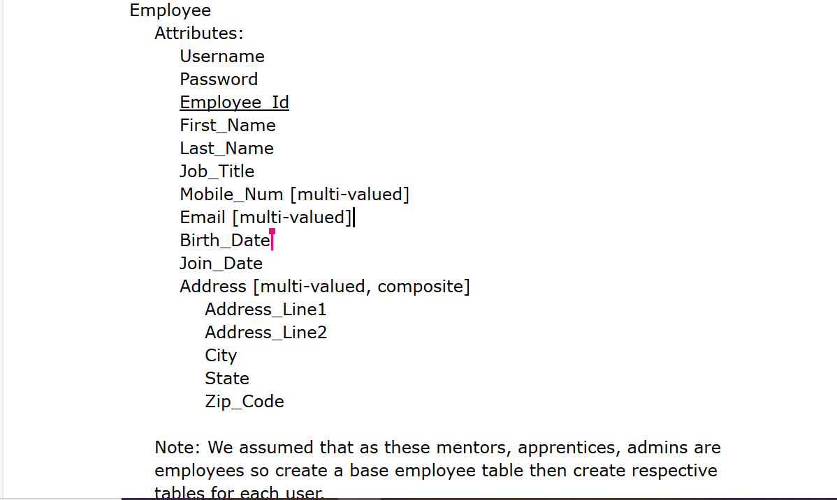
Employee entity

Slide 11
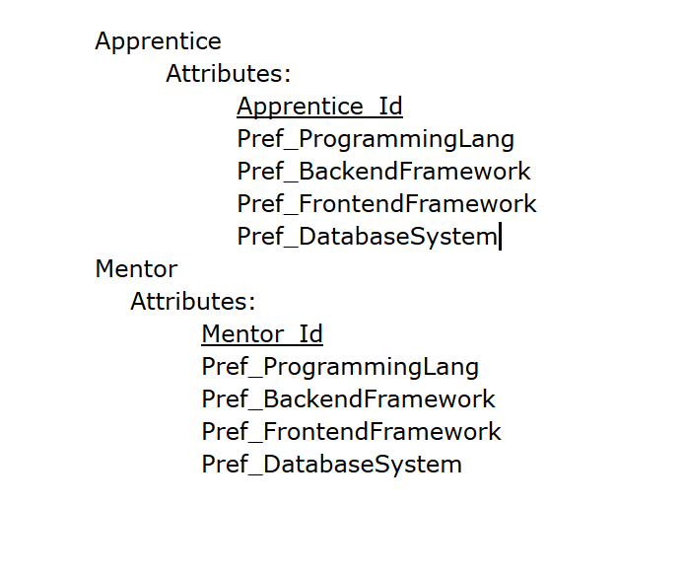
Apprentice Entity
Mentor Entity

Slide 12
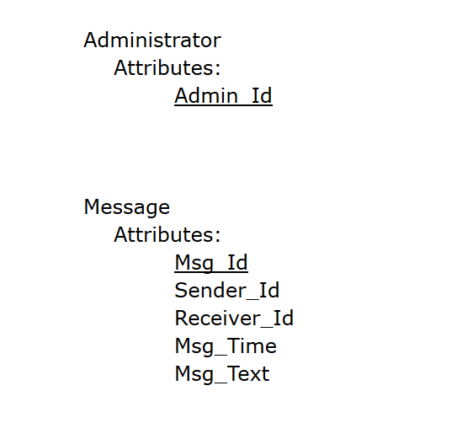
Administrator Entity
Message Entity

Slide 13
Sprint 2

Slide 14
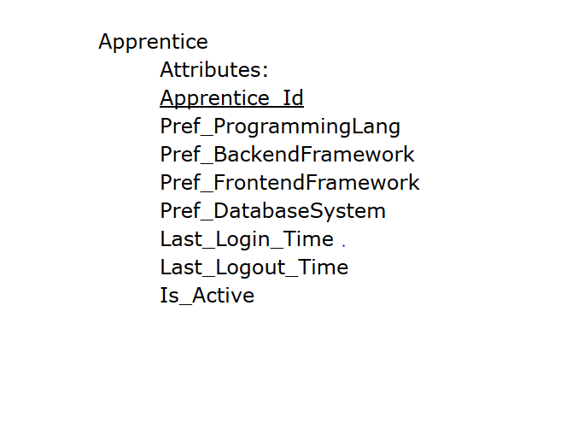
Apprentice entity

Slide 15
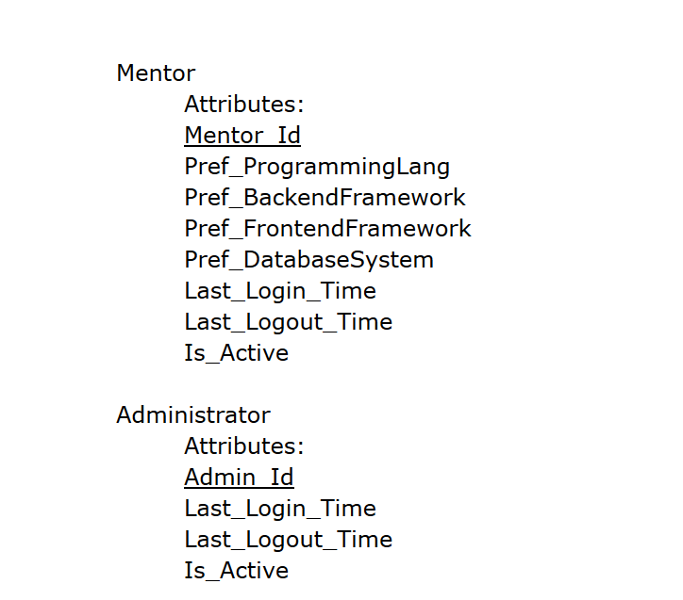
Mentor entity and Administrator entity

Slide 16
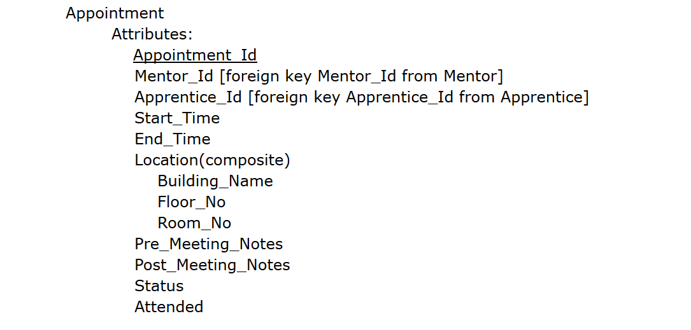
Appointment entity

Slide 17
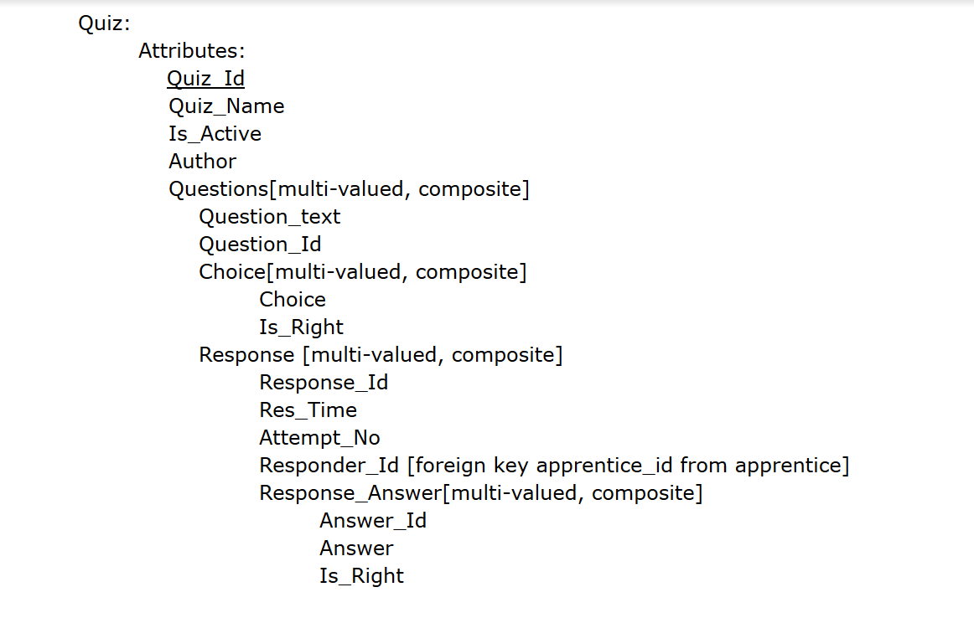
Quiz entity

Slide 18
Sprint 3

Slide 19
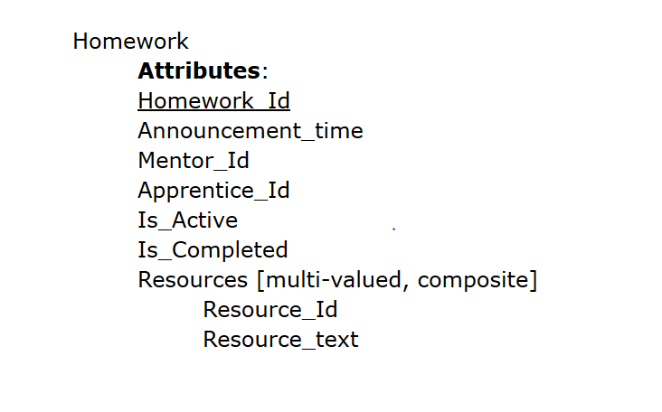
Homework entity

Slide 20
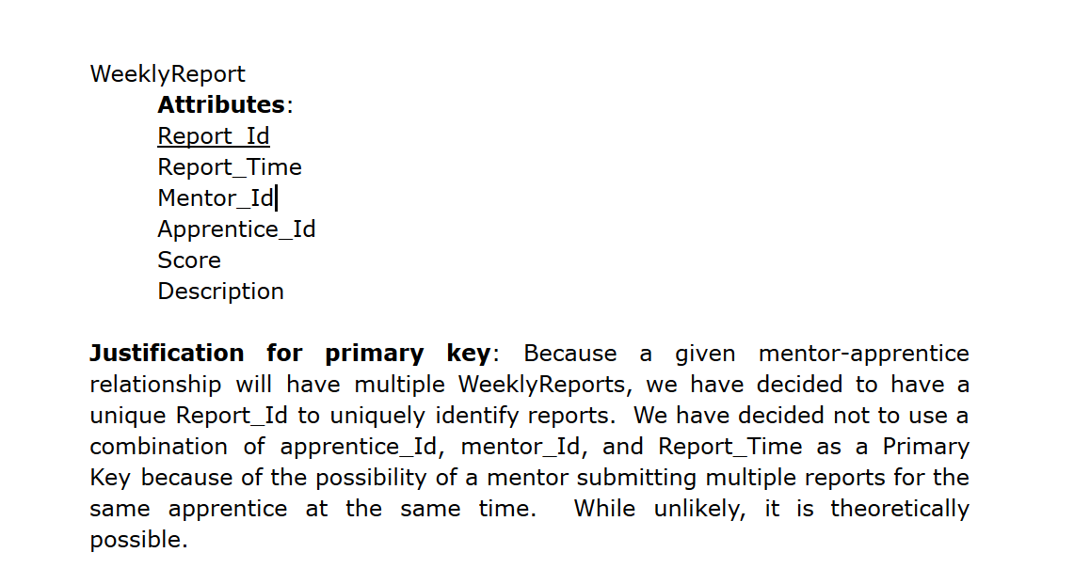
WeeklyReport entity

Slide 21
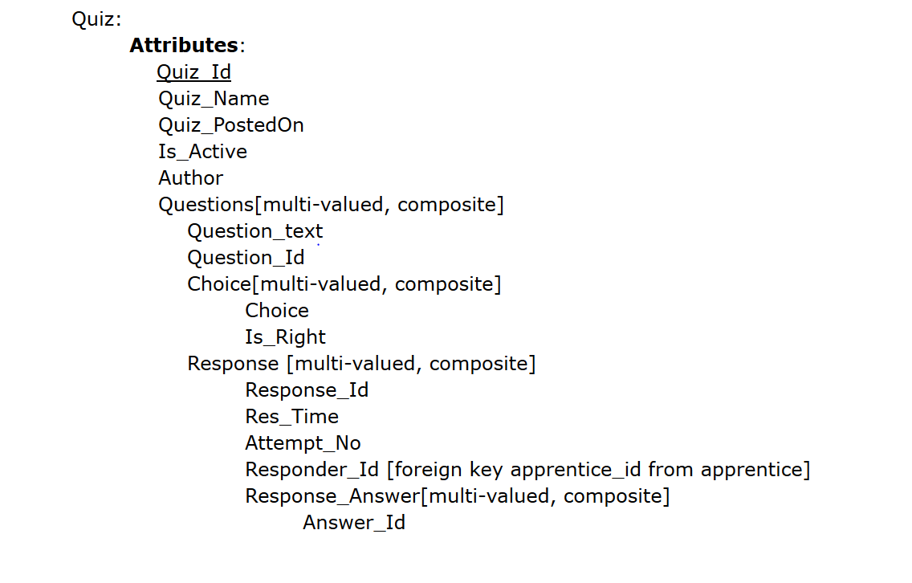
Quiz entity

Slide 22
DETAILED CONCEPTUAL DESIGN - RELATIONSHIP

Slide 23


Sprint 1
Employee send/receive message
Mentor coaches Apprentice
Cardinality: one-to-many
Participation: Employee has partial participation
Message has partial participation
Cardinality: one-to-many
Participation: Mentor has partial participation
Apprentice has total participation

Slide 24



Sprint 2
Employee send/receive message
Mentor schedules/
cancels Appointment
Apprentice responds
/ answers Quiz
Mentor posts Quiz
Cardinality: one-to-many
Participation: Mentor has partial participation
Quiz has total participation
Cardinality: Many to Many
Participation: Apprentice has partial participation
Quiz has partial participation
Cardinality: one-to-many
Participation: Employee has partial participation
Message has partial participation
Cardinality: one-to-many
Participation: Mentor has partial participation
Meeting has total participation

Slide 25
Sprint 3
Mentor submits WeeklyReport
Mentor posts/updates Homework
Apprentice views Homework
Cardinality: one to Many
Participation: Mentor has partial participation
Homework has total participation
Cardinality: One to Many
Participation: Mentor has
partial participation
WeeklyReport has total participation
Cardinality: one to Many
Participation: Apprentice has partial participation
Homework has total participation

Slide 26
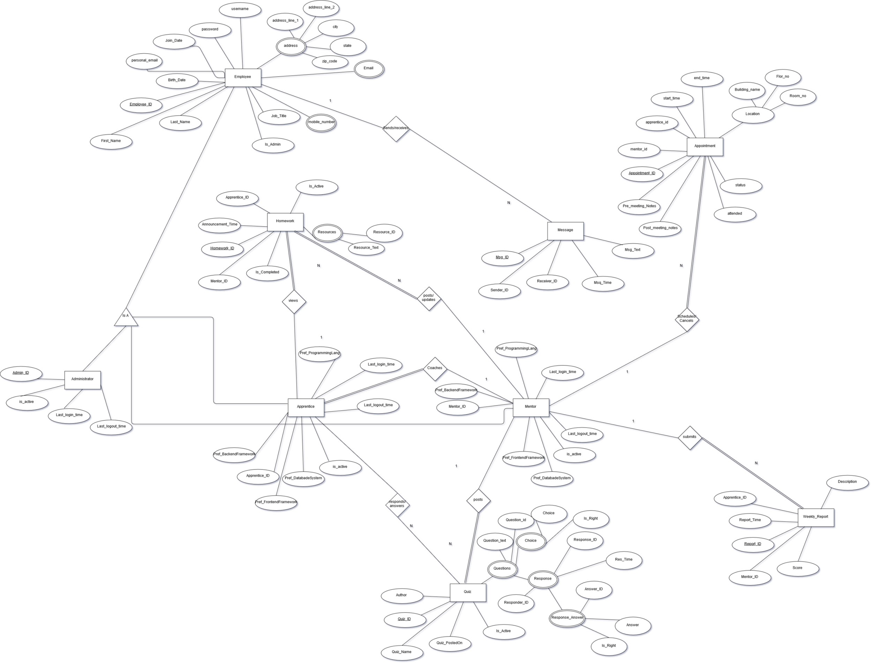
https://www.draw.io/#G1trmxfrYOdUwRx1k2nWqZpqfzo7ACZFt5

Slide 27
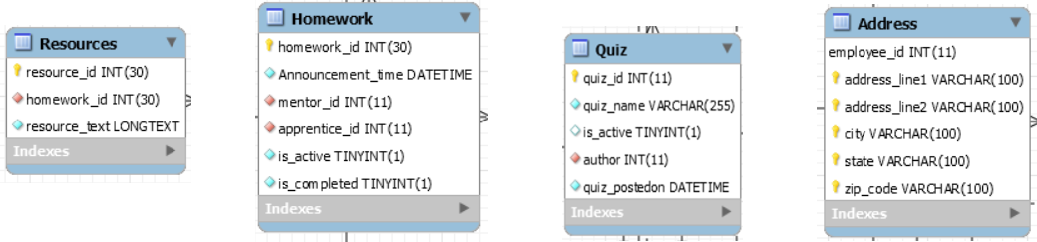
Logical Design part 1

Slide 28
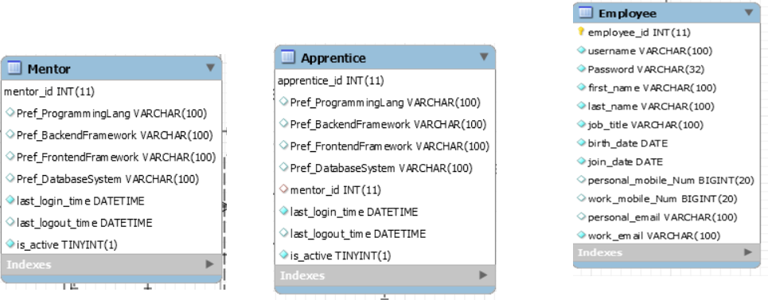
Logical Design part 2

Slide 29
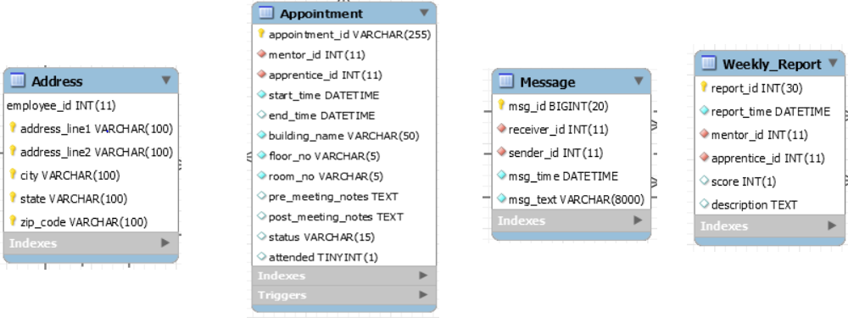
Logical Design part 3

Slide 30
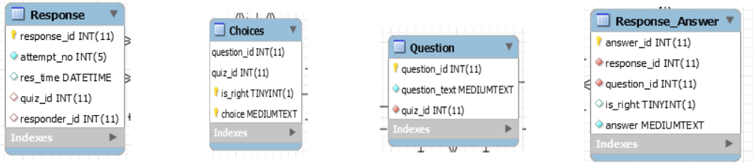
Logical Design part 4

Slide 31
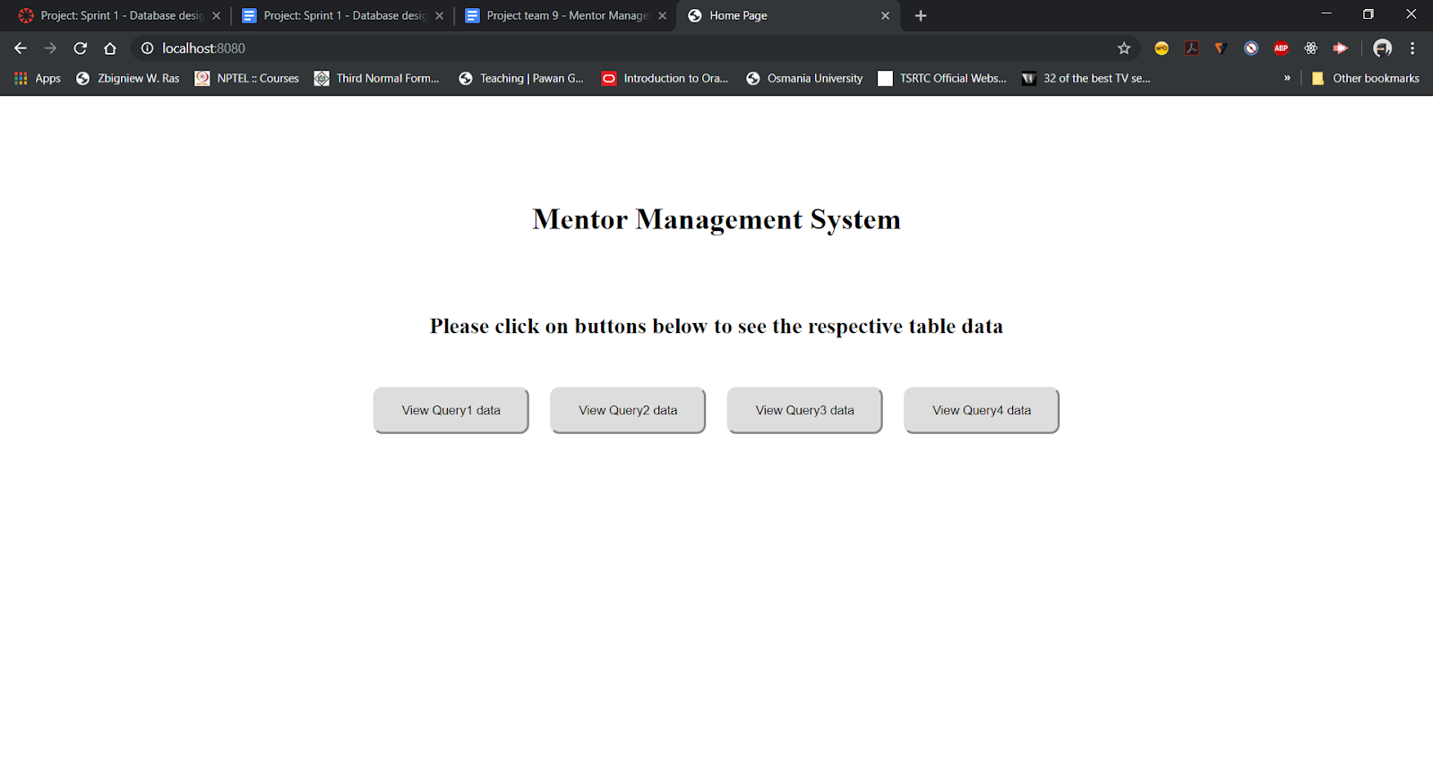
Application Homepage

Slide 32
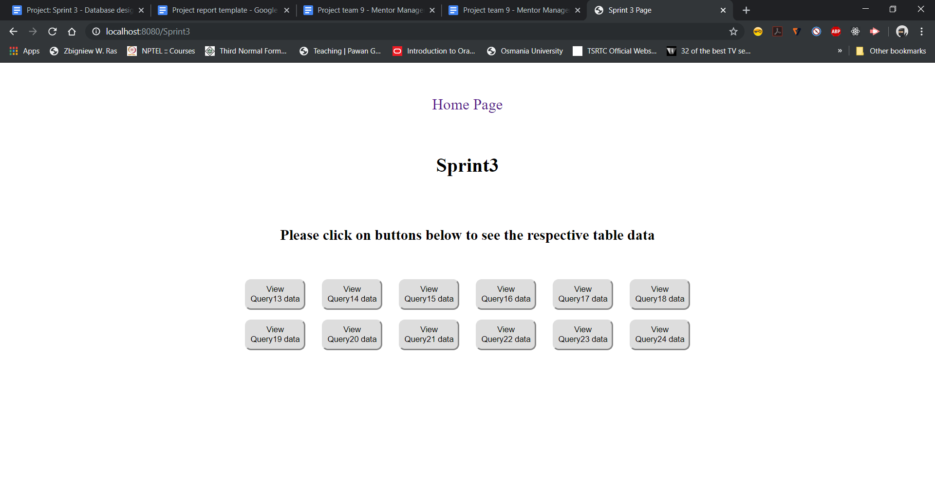
Queries for Sprint3

Slide 33
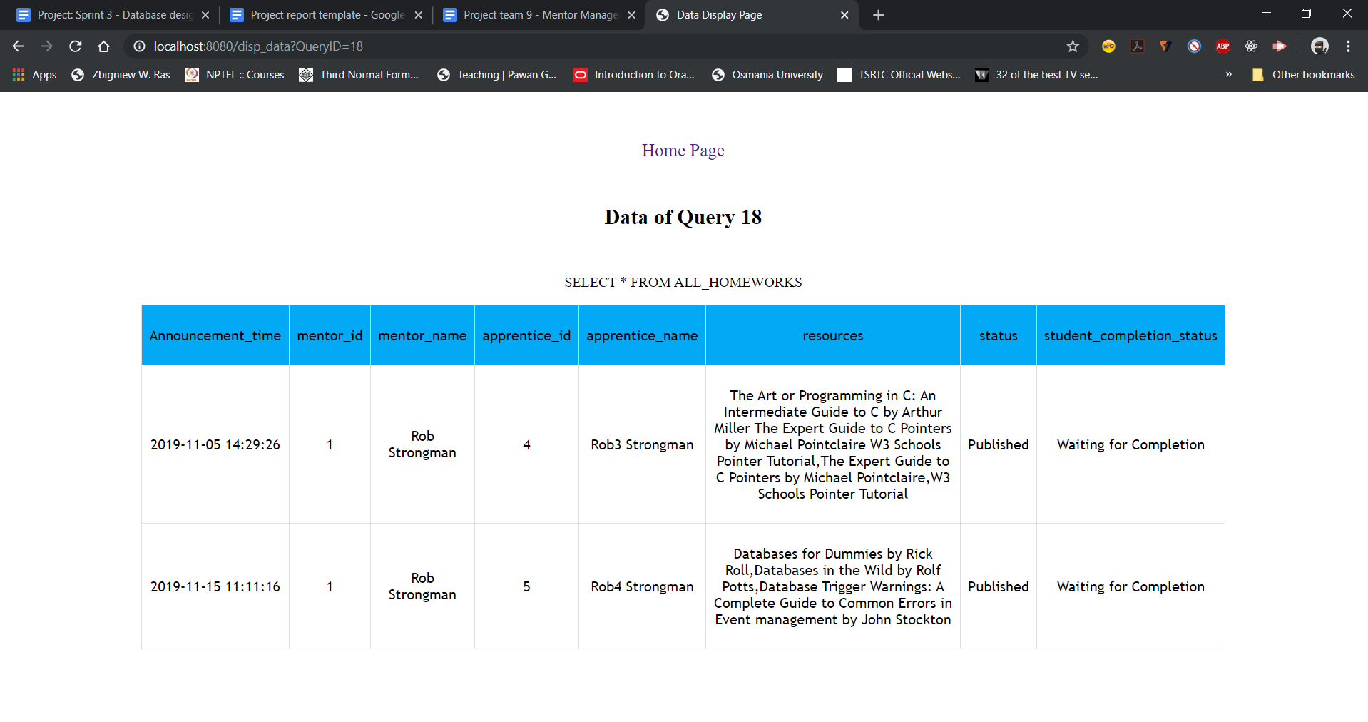
Query 18 Demonstration Select * From ALL_HOMEWORKS

Slide 34
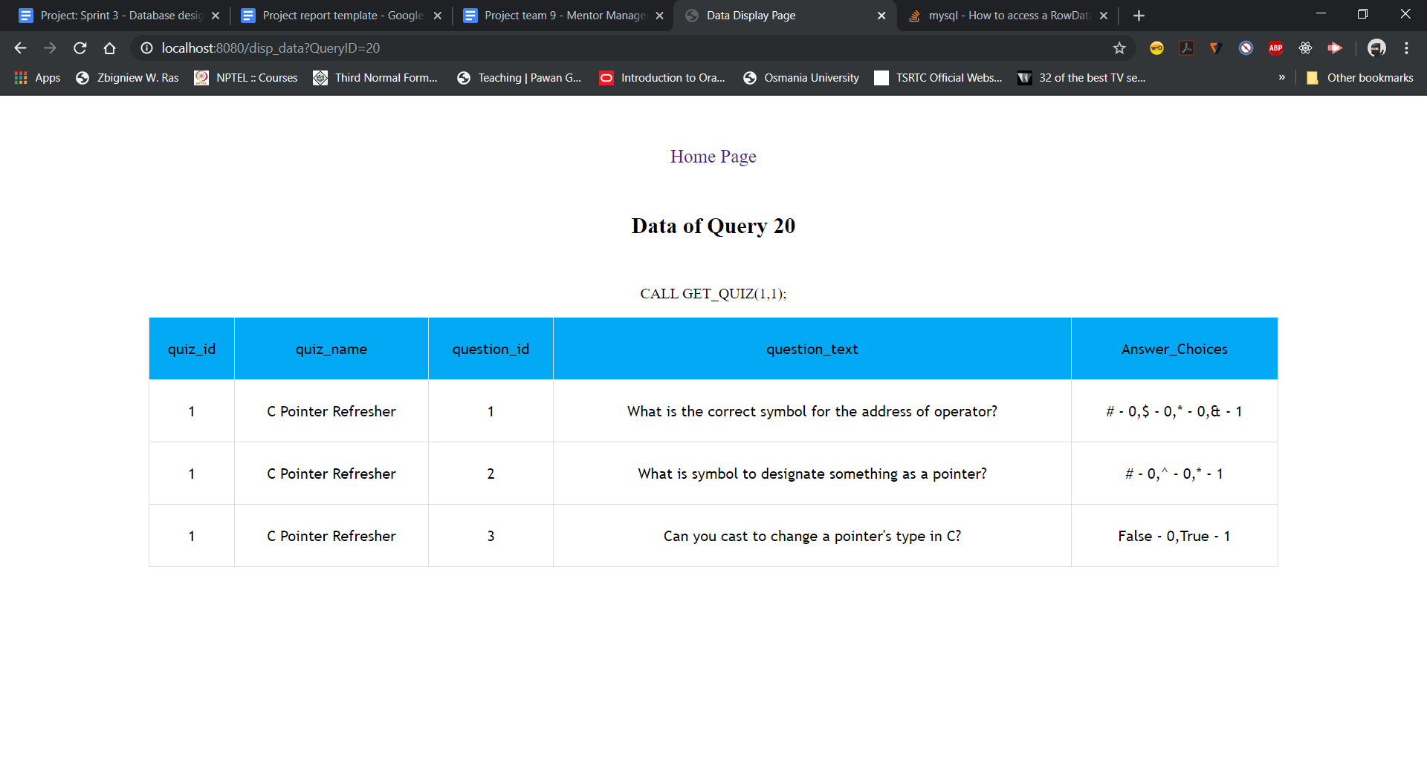
Query 20 Call GET_QUIZ(1,1)

Slide 35
Views
View: EMPLOYEE_INFO
Goal: View consists of basic details of all employees like their id, username, full name, job title, hire date and their address details. It should be accessible to all database users as it consists of basic details about any employee and they cannot update or insert records using this view.
View: MENTOR_PUPILS
Goal: View consists of id’s and names of apprentice and their mentors. Using this view we can find if given apprentice is assigned to any mentor or not. It should be accessible only to Administrator and he’ll be creating relationships and needs this info to do his work.
View: APPRENTICE_INFO
Goal: View shows the data about apprentice respective info which can be used by management/admin.
View: MENTOR_INFO
Goal: View shows the data about meetings
respective info which can be
used by management/admin.
View: ADMIN_INFO
Goal: View shows the data
about meetings respective info which can be used by management/admin.
View: ALL_HOMEWORKS
Goal: View shows the Homeworks
posted and their status respective with
publishing and completion status by student.
View: ALL_REPORTS
Goal: View shows all the reports along
with names of employees involved, score and description.
This can be used to see the performance of apprentices.

Slide 36
Triggers
Trigger: `MMS_Sprint3`.`Appointment_BEFORE_UPDATE` BEFORE UPDATE ON `Appointment`
Goal: This trigger changes the status of attended to true when status of the meeting is marked as done. Update should be done by Mentor as he’ll be using view ``
Trigger: `MMS_Sprint3`.`Appointment_BEFORE_INSERT` BEFORE INSERT ON `Appointment`
Goal: This trigger insert a row with proper status and attended value before inserting,even though wrong values were given in status and attended while inserting.

Slide 37
Stored Procedures
Stored procedure: MAKING_LOGINS_INACTIVE
Goal: This stored procedure captures all(mentor, apprentice, administrator) accounts or their employee ids where mentor, apprentice & administrator didn’t login for last 90 days.
Example: CALL MAKING_LOGINS_INACTIVE();
Stored procedure: GET_QUIZ
Goal: This stored procedure allows application to get quiz related data like questions and answer choices concatenated when quiz_id and is_active values are provided. Example: CALL GET_QUIZ(1,1);
Stored procedure: LOGIN_TIME_UPDATE
Goal: This stored procedure allows application to update login time depending on the id and table code we’ve provided during the call.
Example: CALL LOGIN_TIME_UPDATE(1,'M');
Stored procedure: LOGOUT_TIME_UPDATE
Goal: This stored procedure allows application to
update logout time depending on the id and table code we’ve
provided during the call.
Example:CALL LOGOUT_TIME_UPDATE(1,'M’);
Stored function: SCORE_CALCULATION
Goal: This stored function takes quiz_id, responder_id,
attempt_no as input and returns a decimal value(5,3)
which is percentage apprentice accumulated in given
attempt and quiz.
Example:
SELECT SCORE_CALCULATION(1, 5, 0) AS Score;
SELECT SCORE_CALCULATION(1, 4, 0) AS Score;

Slide 38


